Slide 1
Analyzing Airbnb Listings in la
Stella huang
Stats 202a project 12/03/20

Slide 2



ABOUT THE DATA
Publically available and web-scraped dataset on Airbnb listings (2011- October 2020)
Dataset variables:
Listing
Host
Feature engineered
List of amenities
Geo coordinates
Bath/bed count
Max/max nights
Availability
Ratings
Response rate
Acceptance rate
Verification status
Rental listings
Superhost status
Number of listings within 3 mi
Host age
Time since last review
Region

Slide 3
Prediction results
Objective : predict price of listings in West & Central LA
Data: 12,300 samples and 33 features
Method: 70-30 train/test split; 5 Fold CV
Method | Test RMSE (of log y) | Test Adj. R Sqaured | Top Variables
Linear Regression Baseline approach | 0.4115 | 0.654 | Bedrooms Room type Longitude Bathrooms Availability in next 60 days
Step-wise Regression optimal: 15 variables | 0.4123 | 0.653 | NA
Random Forest 500 trees 11 variables tried at splits | 0.336 | 0.775 | Longitude Availability in next 60 days Num. of listings < 3 miles Room type Latitude

Slide 4
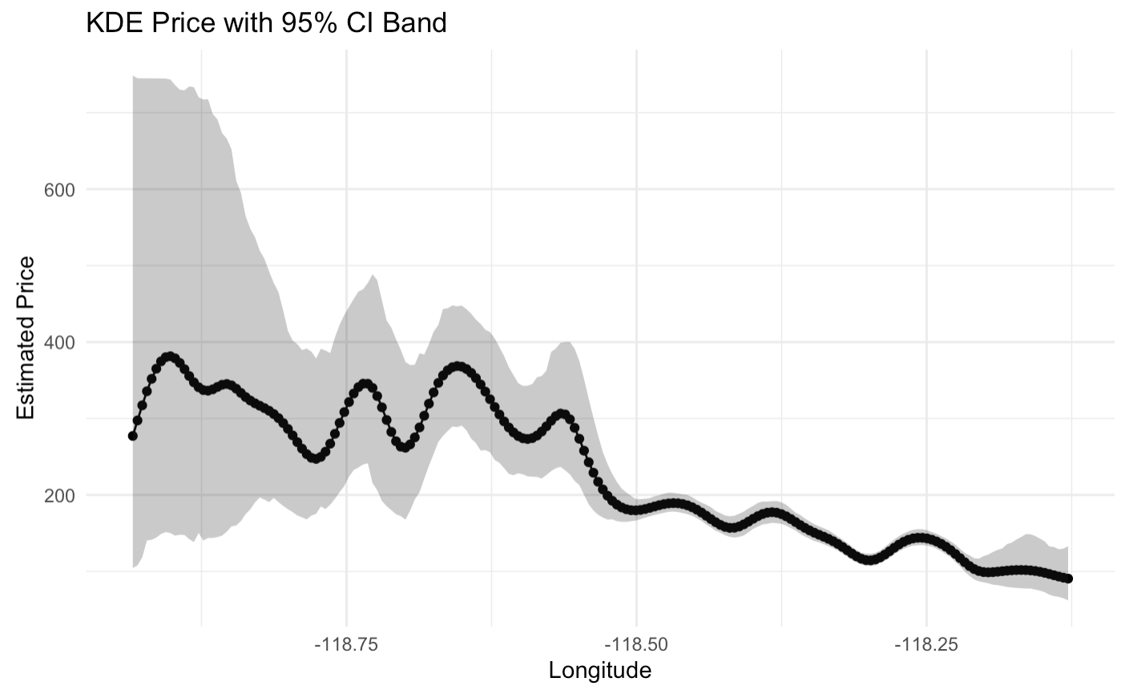
Price vs longitude
Figure: kernel density estimate of price by longitude

Slide 5
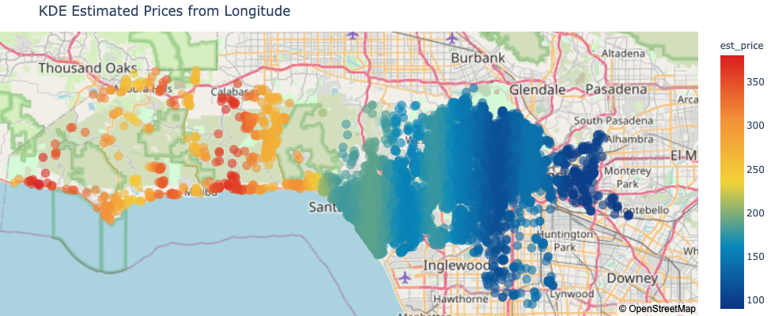
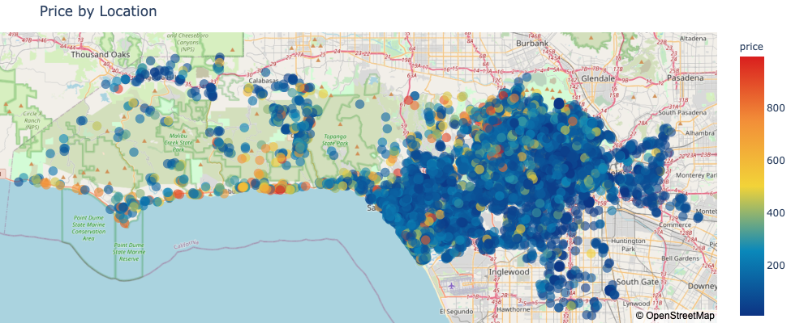
Price vs longitude

Slide 6
FUTURE/next steps
Data:
Quantify qualitative variables
Detect anomalies (outdated/unusual listings)
Analysis:
Geospatial analysis
Multivariate KDE

Slide 7
Questions?

